Slide 1
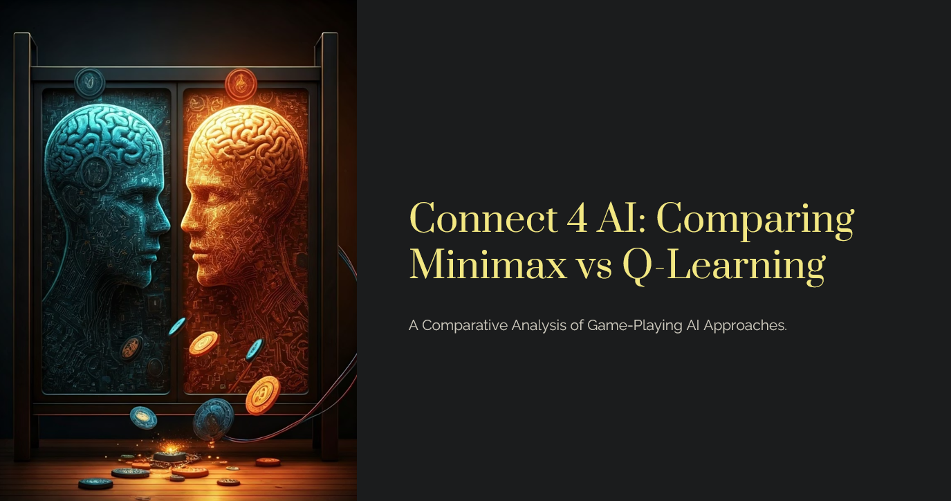

Slide 2

Project Overview
AI Implementations
Game Modes
Minimax with Alpha-Beta pruning, Q-Learning agent, and Normal Player.
Minimax vs Normal Player, Minimax vs Q-Learning, Q-Learning vs Normal Player.
Goal
Analyze strengths, weaknesses, and performance of each AI approach.

Slide 3
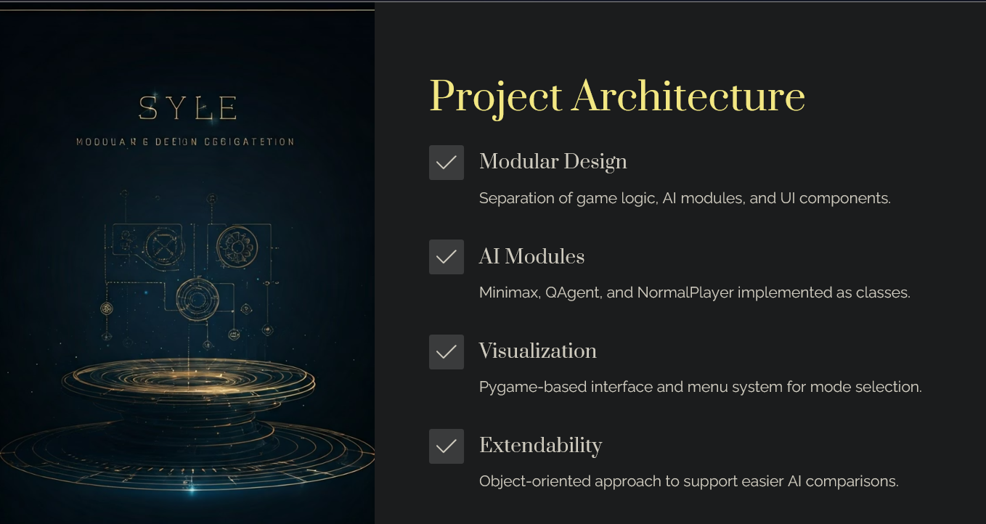

Slide 4
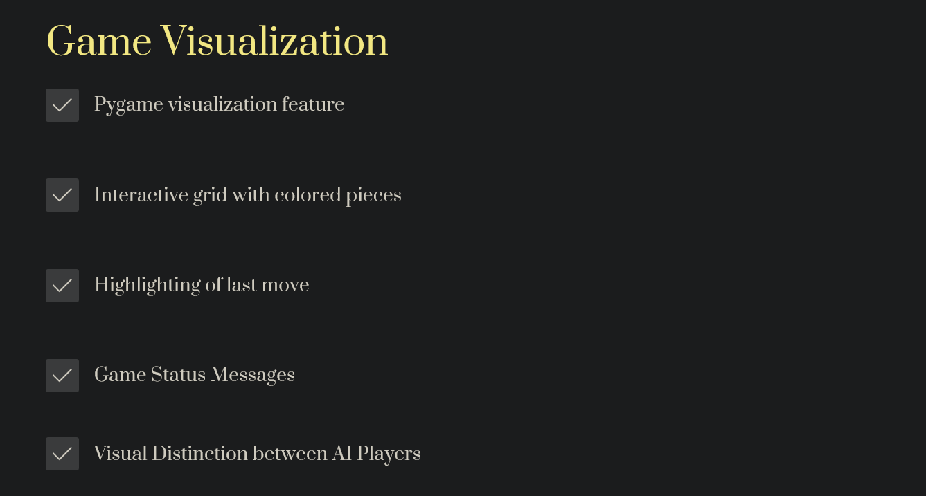

Slide 5
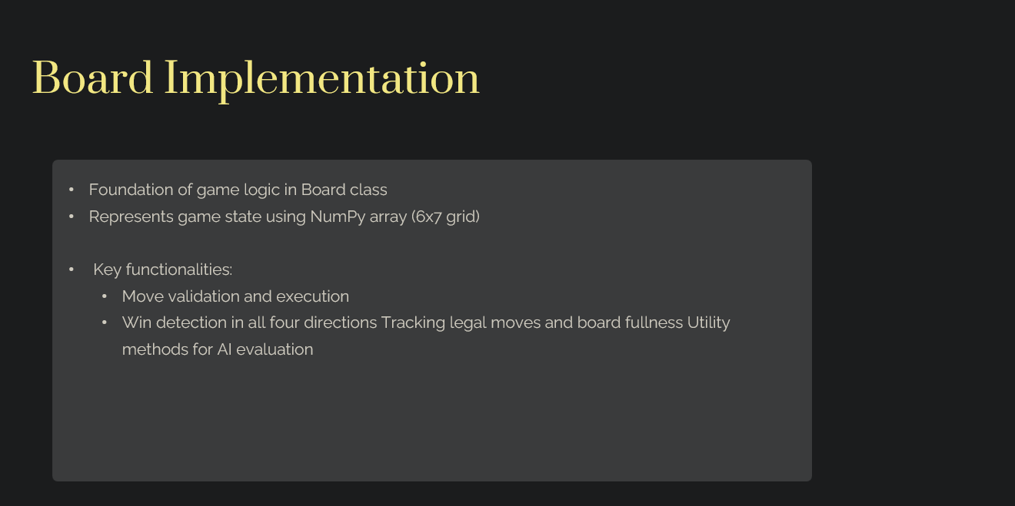

Slide 6
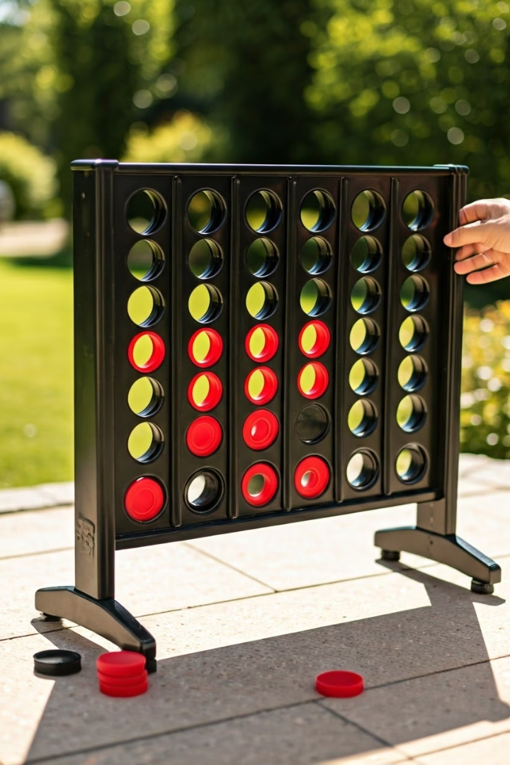

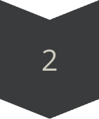

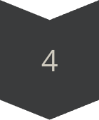
Normal Player Implementation
Win if Possible
Checks for a winning move on the board.
Block Opponent
Blocks opponent's potential winning moves.
Random Move
Chooses random legal move if no threats.
Simulation
Uses temporary board copies to test moves.

Slide 7
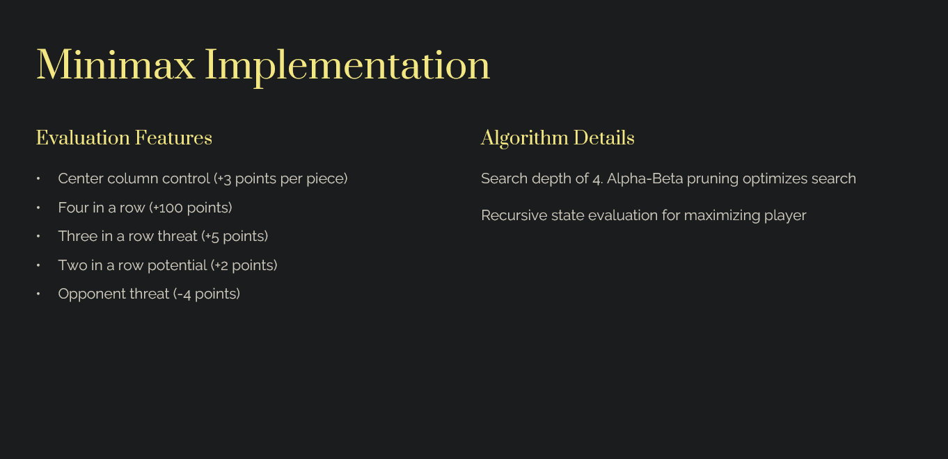

Slide 8

Minimax: Strengths and Limitations
Strengths
Guaranteed optimal decisions within depth
No prior training needed
Consistent and explainable moves
Limitations
Exponential growth in computation
Fixed strategy, no opponent adaptation
Memory intensive for deep searches

Slide 9

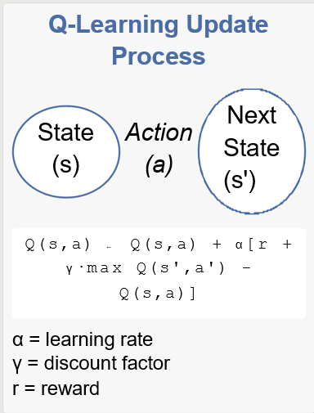
Q-Learning Concept
Model-free reinforcement learning algorithm
Learns value function Q(s,a) for state-action pairs
Updates Q-values based on rewards and future expected returns
Bellman equation: Q(s,a) ← Q(s,a) + α[r + γ·max Q(s',a') - Q(s,a)]

Slide 10

Q-Learning Implementation
State Representation
Flattened board stored as string key.
Training
100,000 episodes against Normal Player using ε-greedy strategy (ε=0.1).
Learning Parameters
Alpha=0.5, Gamma=0.9; rewards for wins, losses, draws.
Q-Table Updates
Updates values using Bellman equation after each move.

Slide 11
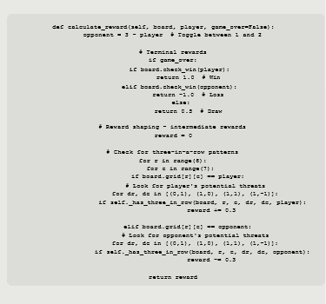
Reward Shaping in Q-Learning
Connect 4 has sparse rewards (only at game end)
Intermediate rewards guide learning toward good strategies
Implemented reward shaping:
Penalty (-0.3) when opponent creates three in a row
Reward (+0.3) for creating three in a row
Helps address credit assignment problem
Balance between too much and too little shaping

Slide 12
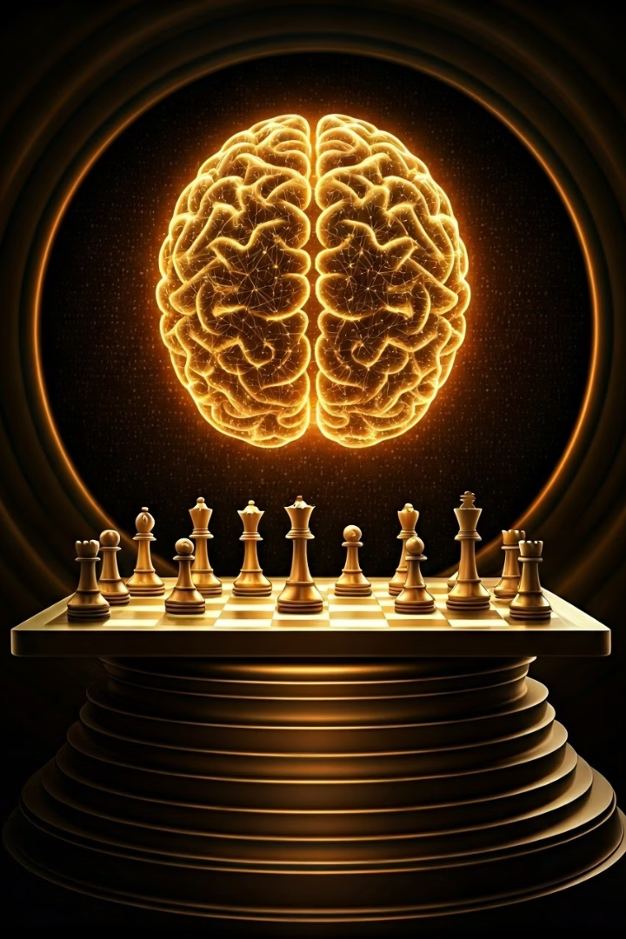
Q-Learning: Strengths and Limitations
Strengths
Adapts to opponent strategies
Fast decisions after training
Discovers unexpected tactics
Limitations
Requires extensive training time
Performance varies with training quality
Difficult to interpret learned policies

Slide 13
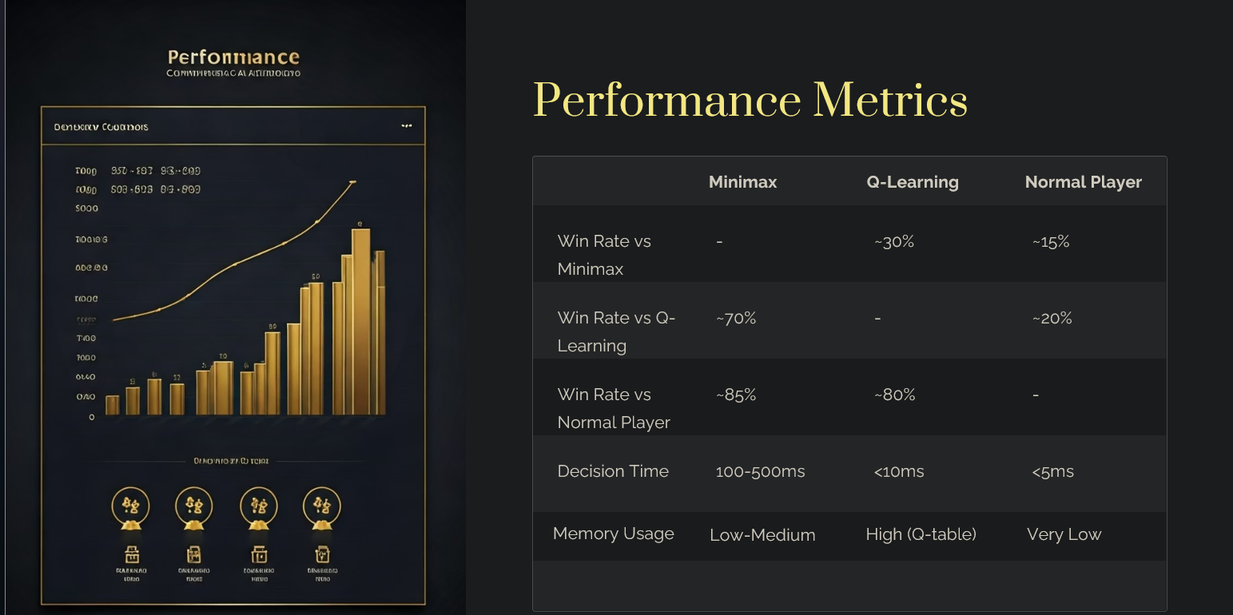

Slide 14

Conclusion and Future Work
Key Findings
Minimax excels due to manageable complexity
Q-Learning holds promise with more training
Hybrid models may combine strengths
Future Directions
Deep Q-Networks for better generalization
Monte Carlo Tree Search integration
Self-play training enhancements
Parallelized Minimax for deeper search
Enhanced visual tools for analysis

Slide 15

Thank You

